Slide 1


Slide 2


Slide 3
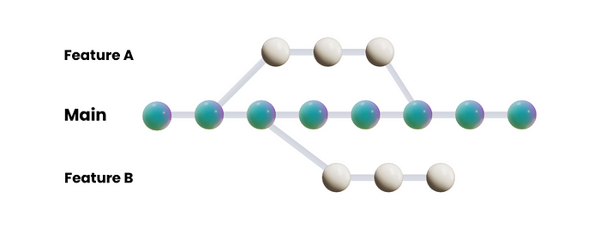
Branches

Slide 4
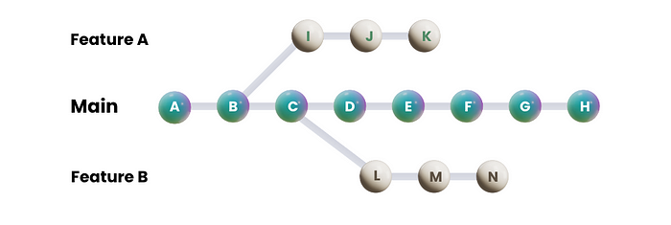
Commits

Slide 5
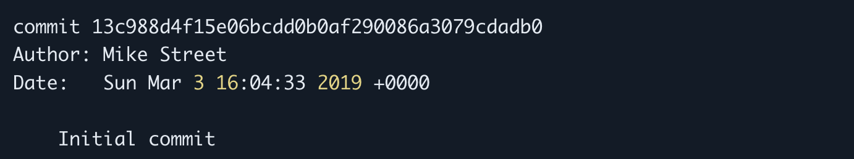
Hash

Slide 6
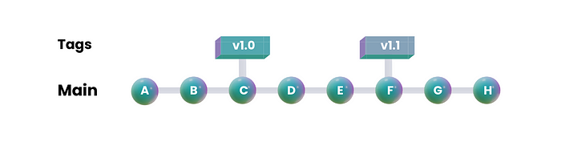
Tags

Slide 7
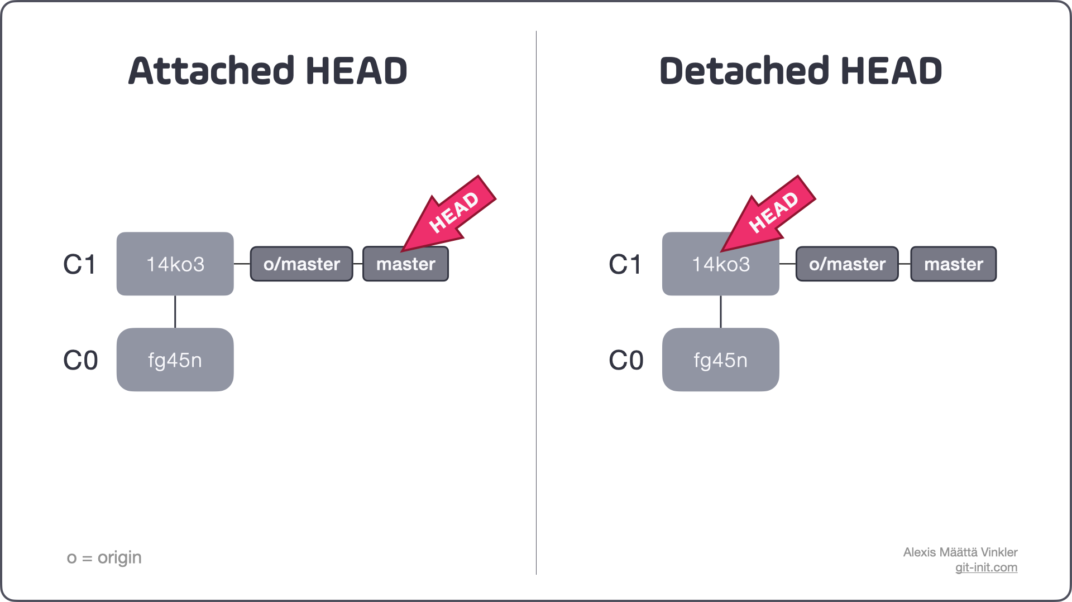
HEAD

Slide 8
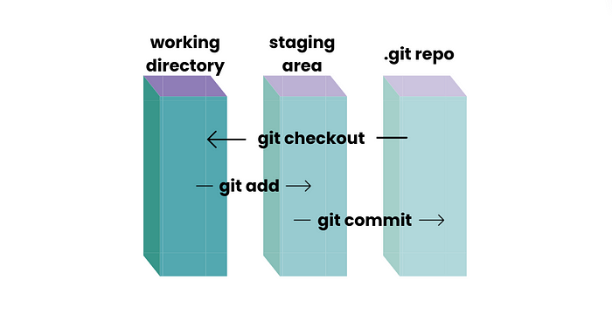
Stages

Slide 9
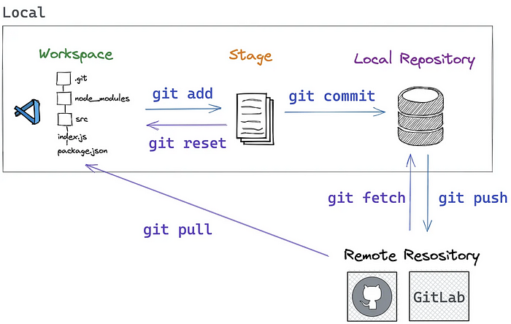
Getting Started With Git

Slide 10
Credential Setup

Slide 11
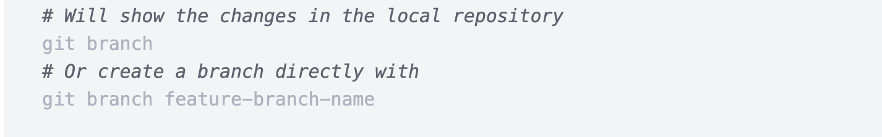
Working with Branches

Slide 12
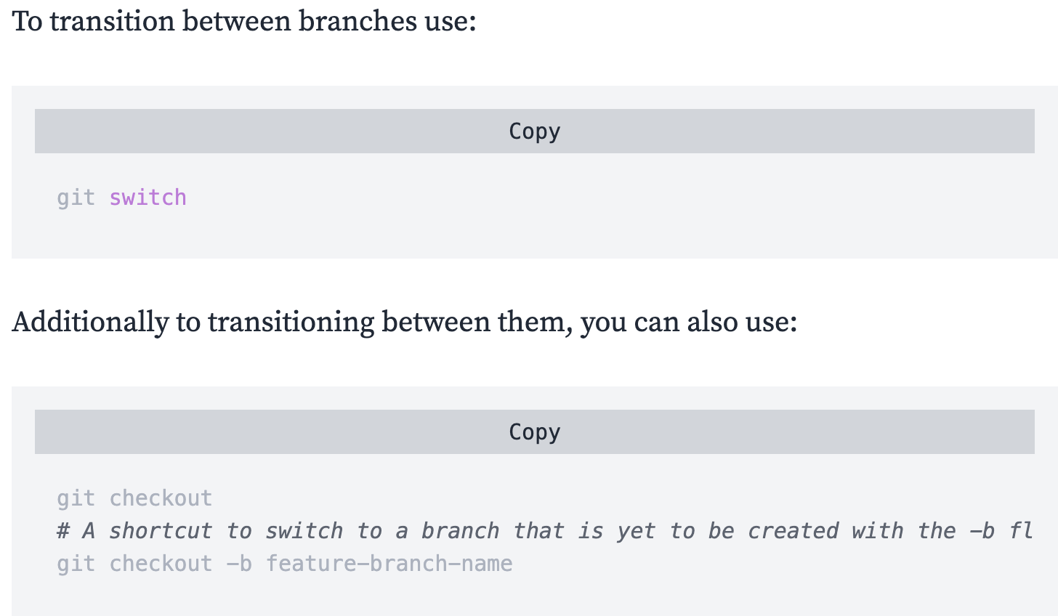

Slide 13
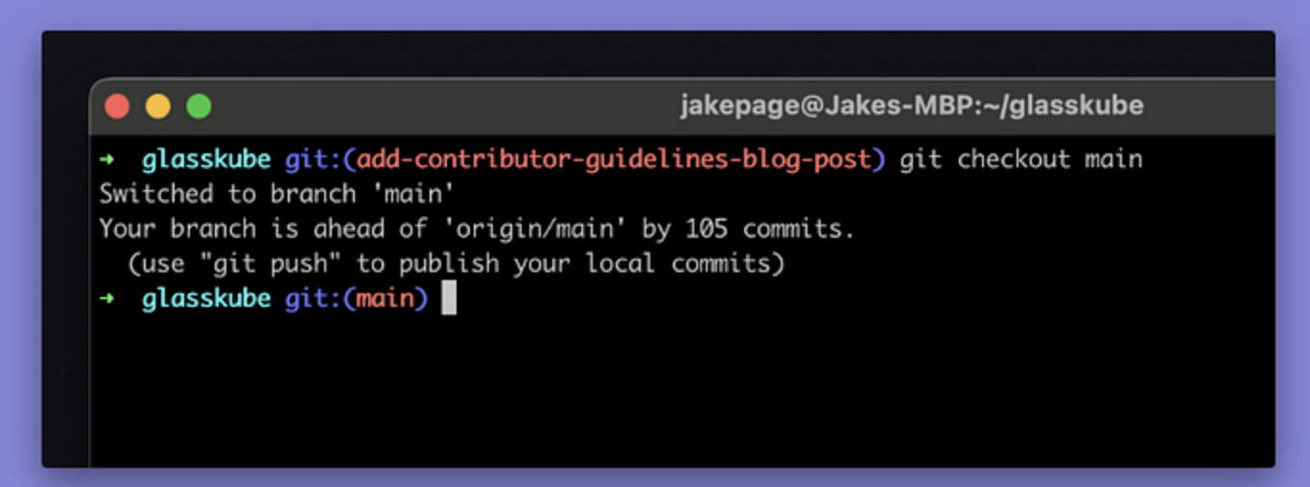
Check status

Slide 14
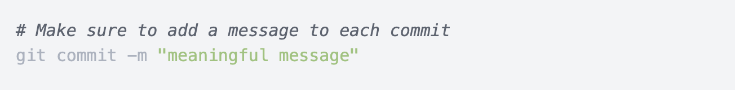
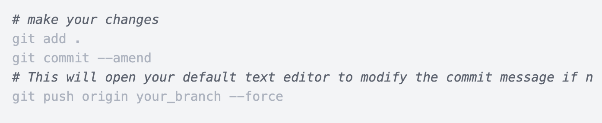
Working with Commits

Slide 15
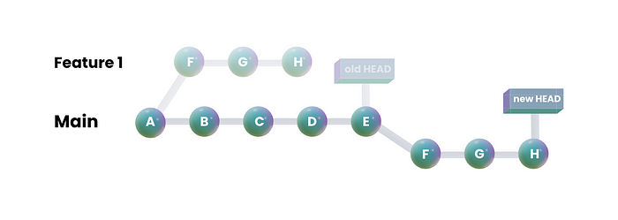
Rebasing & Merging

Slide 16
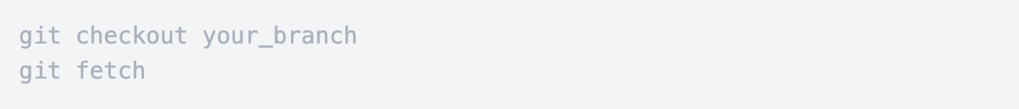
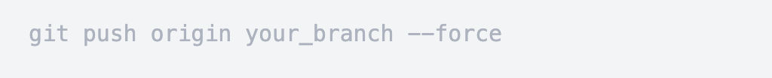

Slide 17
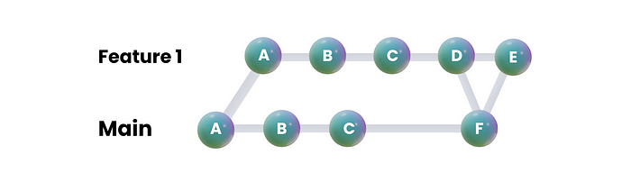
Squashing commits

Slide 18
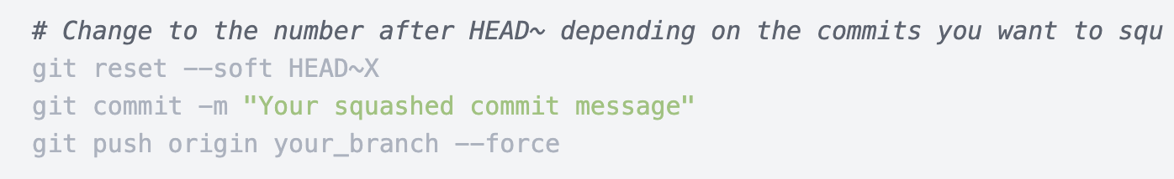

Slide 19
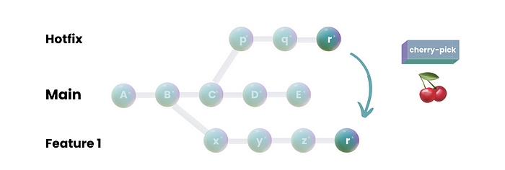
Cherry Picking

Slide 20
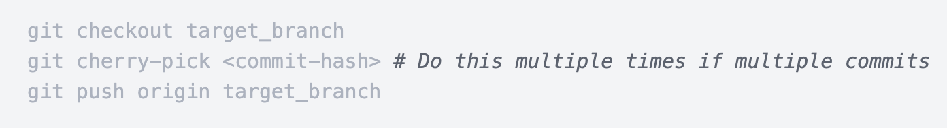

Slide 21
Advanced Git Commands

Slide 22
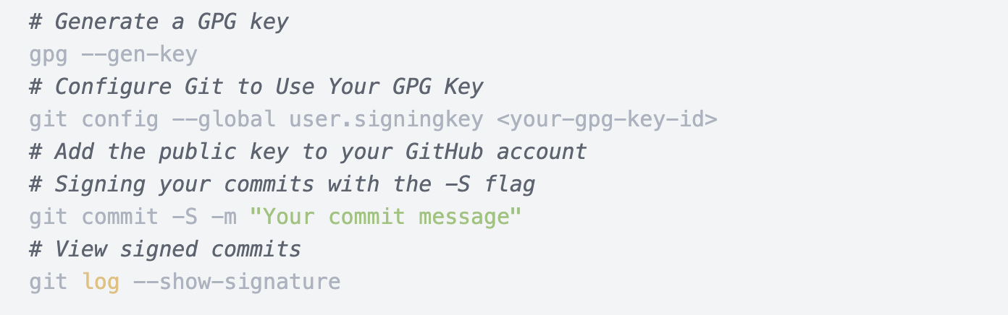
Signing Commits

Slide 23
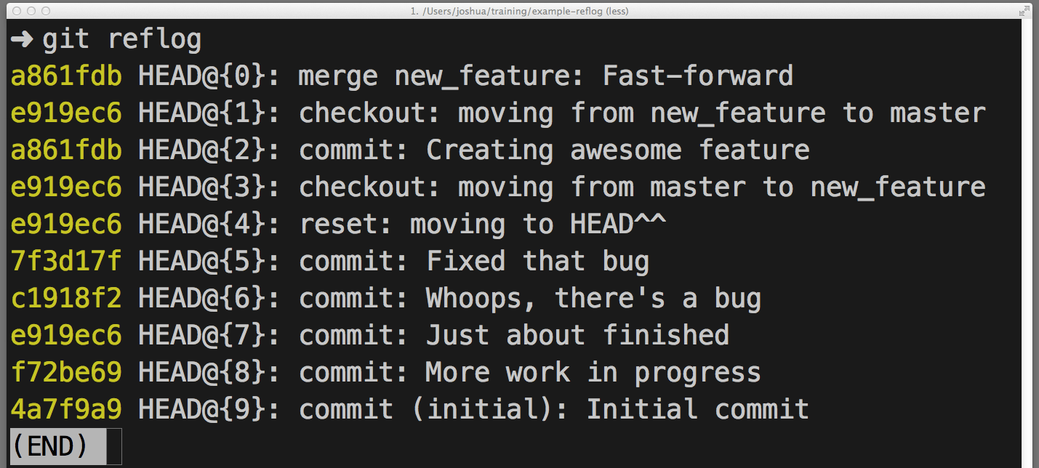
Git Reflog
Recovering lost commits or branches
Debugging and troubleshooting
Undoing mistakes

Slide 24
Interactive Rebase
Pick ("p")
Reword ("r")
Edit ("e")
Squash ("s")
Drop ("d")

Slide 25
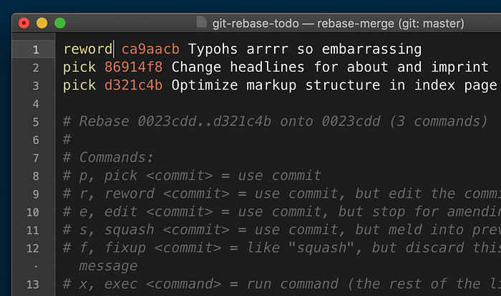
How to do interactive Rebase
git rebase -i HEAD~4

Slide 26

Collaborating with Git

Slide 27
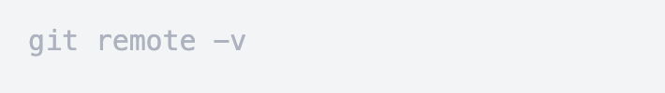
Origins vs Upstream
Upstream on the other hand refers to the original repository from which your repository was forked.

Slide 28

Conflicts

Slide 29
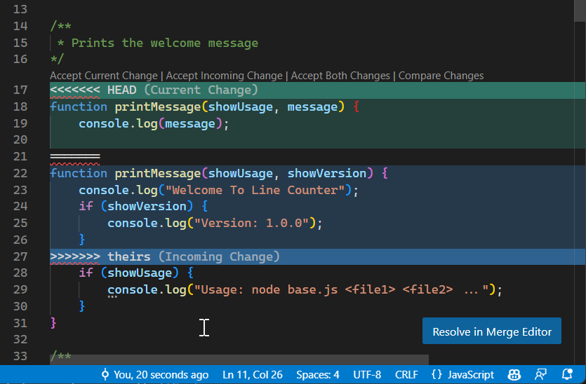

Slide 30
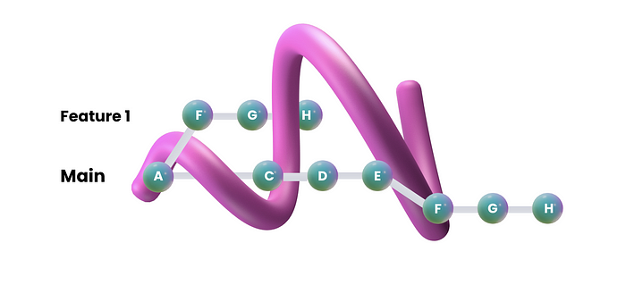
Popular Git Workflow

Slide 31


Slide 32
Feature Branch Workflow 🌱
Strength: Isolation of changes and reducing conflicts.
Weakness: Can become complex and require diligent branch management.

Slide 33
Gitflow Workflow 🌊
Strength: Suitable for projects with scheduled releases and long-term maintenance.
Weakness: Can be overly complex for smaller teams

Slide 34
Forking Workflow 🍴
Strength: Encourages collaboration from external contributors without granting direct write access to the main repository.
Weakness: Maintaining synchronization between forks and the main repository can be challenging.

Slide 35
Pull Request Workflow ⏩
Strength: Facilitates code review, collaboration, and knowledge sharing among team members.
Weakness: Dependency on human code reviewers can introduce delays in the development process.

Slide 36
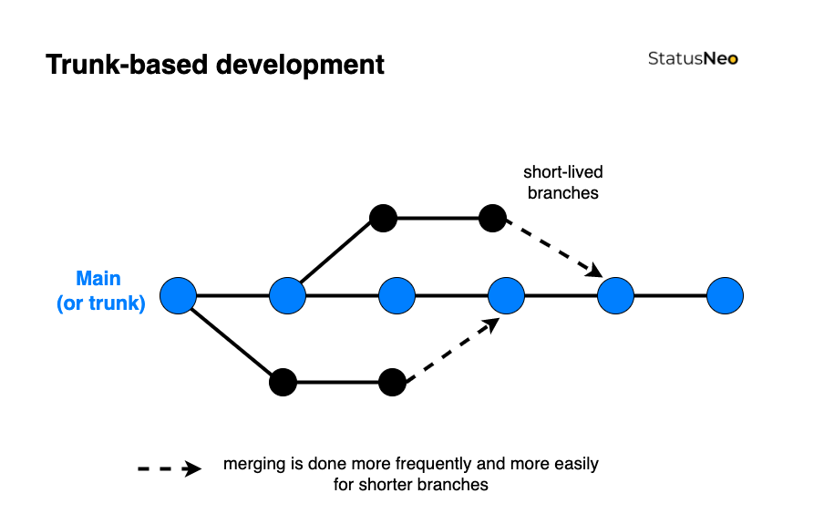
Trunk-Based Development 🪵

Slide 37
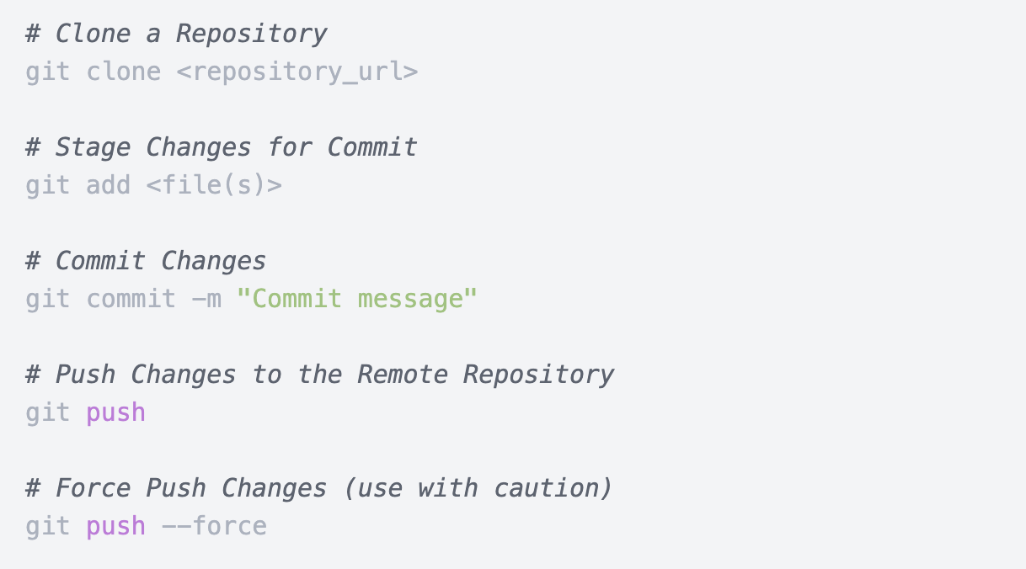

Slide 38
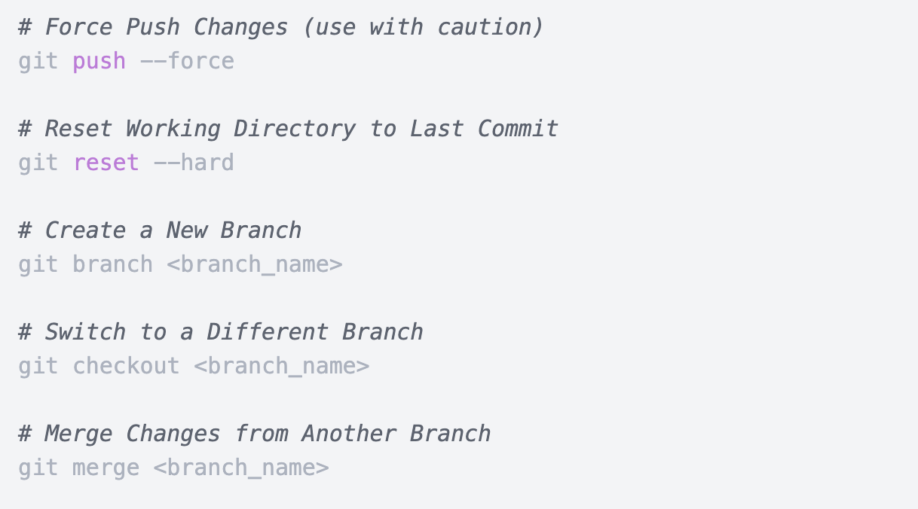

Slide 39
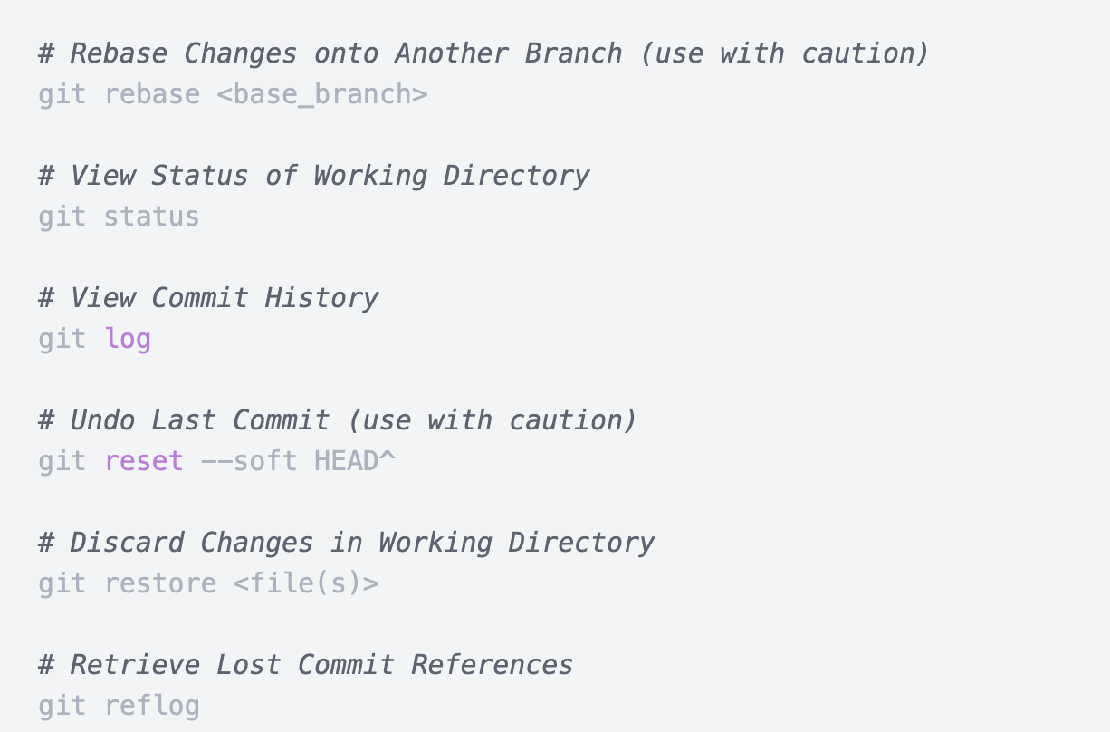

Slide 40
